Slide 1
Programming pradgism - Functional programming -
Recursion

Slide 2
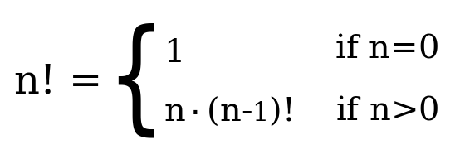
1. Definition
Idle state
Boundary / Edge condition
If boundary / edge condition is not defined $⇒$ Stackoverflow

Slide 3
2. Example: maximum function
maximum' :: (Ord a) => [a] -> a
maximum' [] = error "maximum of empty List"
maximum' [x] = x
maximum' (x:xs)
| x > maxTail = x
| otherwise = maxTail
where maxTail = maximum' xs

Slide 4
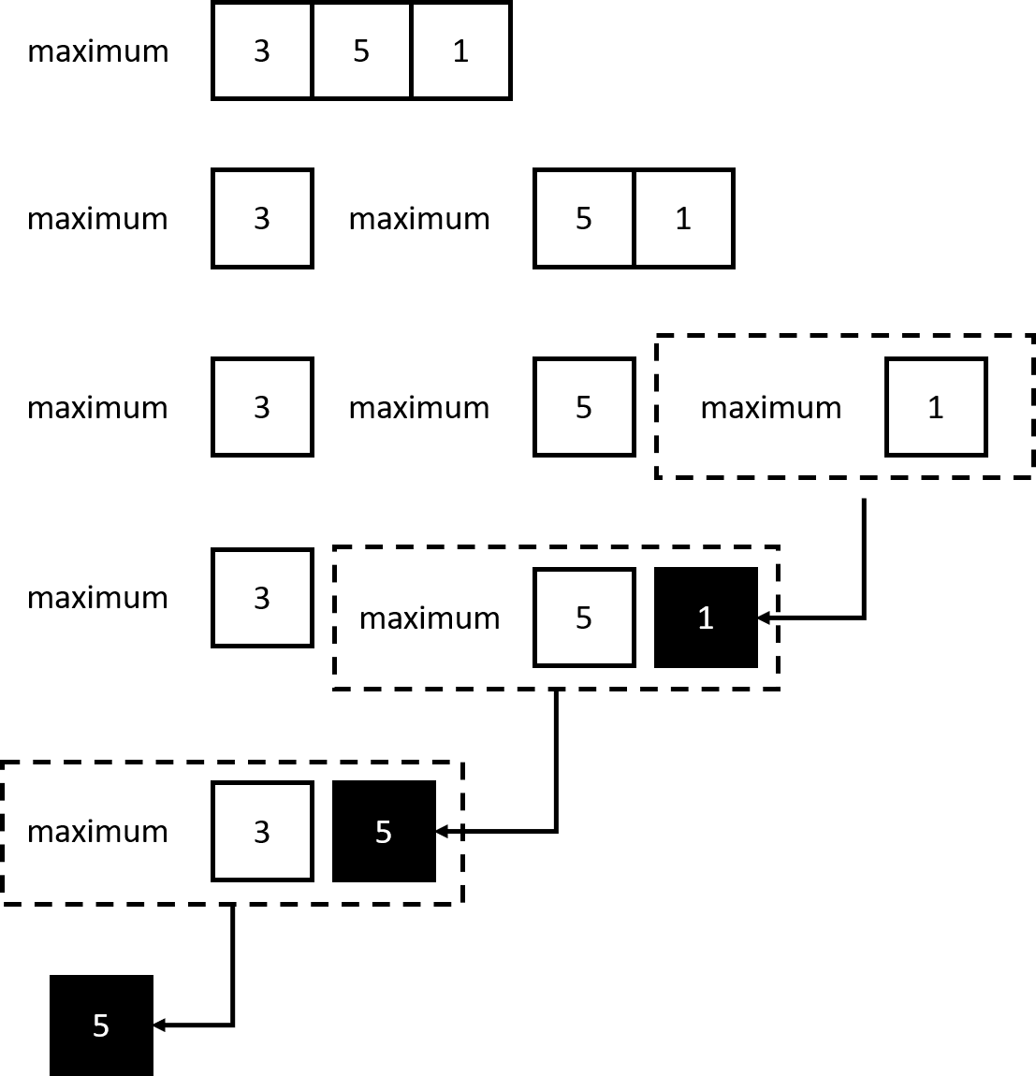
2. Example: maximum function

Slide 5
2. Example: maximum function
maximum' :: (Ord a) => [a] -> a
maximum' [] = error "maximum of empty List"
maximum' [x] = x
maximum' (x:xs) = max x (maximum' xs)

Slide 6
2. Example: replicate function
replicate':: (Integral a) => a -> b -> [b]
replicate' k x
| k <= 0 = []
| otherwise = [x] ++ replicate1 (k - 1) x

Slide 7
2. Example: take function
take':: (Integral a) => a -> [b] -> [b]
take' k _
| k <= 0 = []
take' _ [] = []
take' k (x:xs) = x : take' (k -1) xs

Slide 8
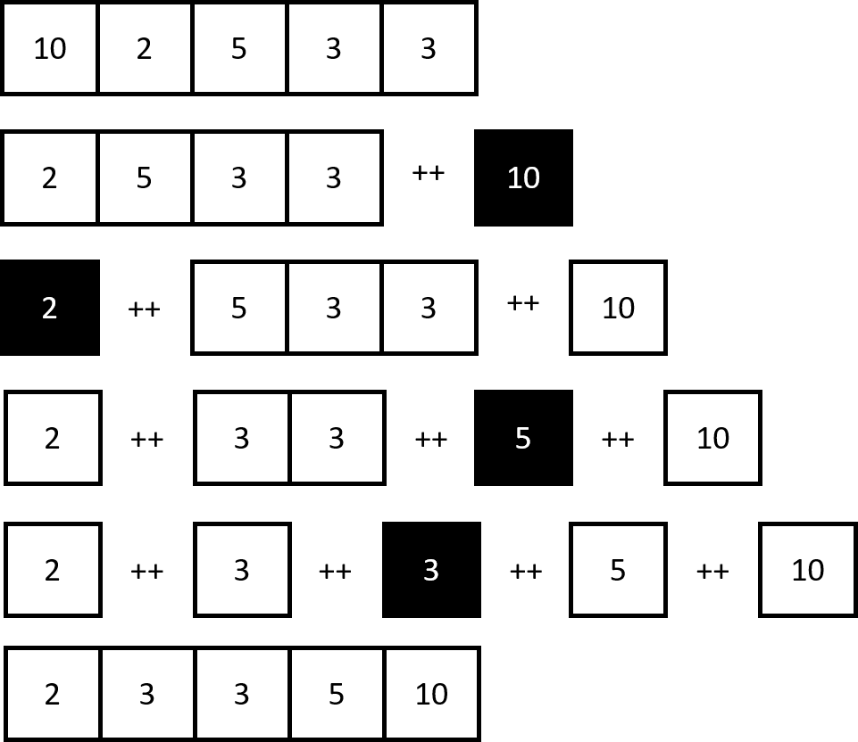
2. Example: reverse function

Slide 9
2. Example: take function
reserve' :: [a] -> [a]
reserve' [] = []
reserve' (x:xs) = (reserve' xs) ++ [x]

Slide 10
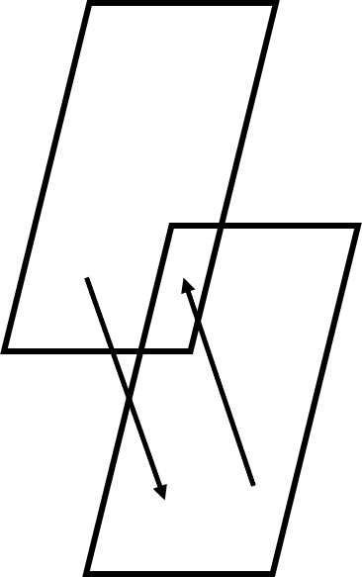
2. Example: repeat function
repeat' :: a -> [a]
repeat' x = x:repeat' x

Slide 11
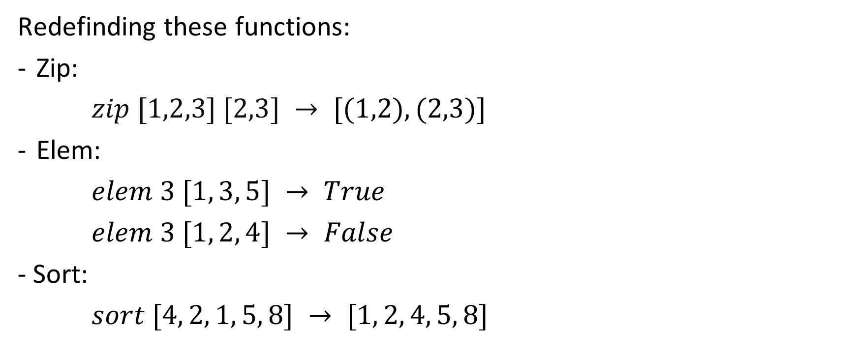
3. Homeworks
Redefinding these functions:
Zip:
$zip [1,2,3] [2,3] → [(1,2),(2,3)]$
Elem:
$elem 3 [1, 3, 5] → True$
$elem 3 [1, 2, 4] → False$
- Sort:
$sort [4, 2, 1, 5, 8] → [1, 2, 4, 5, 8]$

